Slide 1
- Testing with Postman, Newman, Mockoon - REST and GraphQL - An Overview 0.1 Rob Allan

Slide 2


Summary of what is included here
Postman
Newman Installation
Mockoon
Some Sample Projects
REST to Mockoon
REST to dummyAPI
GraphQL – as well as a quick overview
Strictly confidential

Slide 3
Postman and Automation
Postman tests can be automated to run and can embed Java script tests.
The structure has 2 main files
uses an environment file that holds variables including hosts, ports, usernames, passwords and specific authentication values associated with Windows NTLM type credentials.
uses a collection to define the scripts for the various APIs
The various scripts in the collection then use these environment variables annotated as {{xyz}} in the scripts.
Postman allows the user to implement tests in Javascript. Postman provides some samples and these are then exploited within the specific test that have been created.
A typical approach that has been used here is check for each of the cases above
Correct response code
A response in a reasonable time period 2 seconds)
Where we are checking data that is it correctly represented in JSON
We test a sample of the returned fields are correct
We check the reference data is present
Strictly confidential

Slide 4
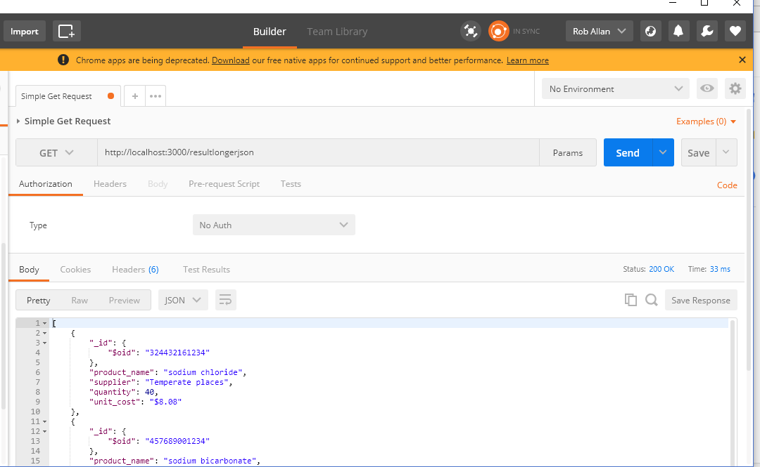
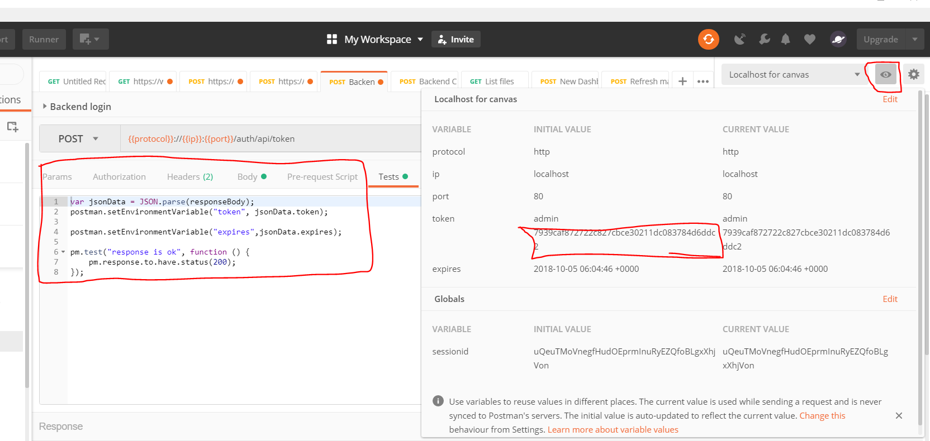
Postman Setup
Postman is a simple tool that allows the user to send in REST message, e.g. to GET a resource. The user can create several different folders etc, set headers, choose the method and the URL to call. The application can be standalone or a plug in to Chrome. The screen shot below shows the system - in this case calling a local Mockoon server and getting an json message back.
Tests can be aggregated into logic groups on folders. It is possible to create an environment (with a set of settings). Those setting can then be used in a URL, message headers etc. It is possible to extract data from one message, and then use that later, for example updating the environment settings. The data can be extracted by running javascript commands on the returned data - as shown below. The screen shot also show the environment settings being displayed, with the acquired values. Addtionlly tets can be written using Javascript and then automated using Newman.
Strictly confidential

Slide 5
Newman Setup
Install node js - run node -v to show that you have installed it
Download and Install Newman - if you have nodejs installed, then you can run npm install -g newman
Download and load the collection
Download and load the environment
Edit the environment and implement your username and password in the environment file - save the environment file. You may have a slightly different name here.
Run Newman collection and updated environment file
Installation of newman
Follow the preconditions - nodejs, python, check node is installed, VS runtime - run node –v to check node is installed
This is as described at - https://blog.getpostman.com/2015/04/09/installing-newman-on-windows/
Run the following command - npm install -g newman
Strictly confidential

Slide 6
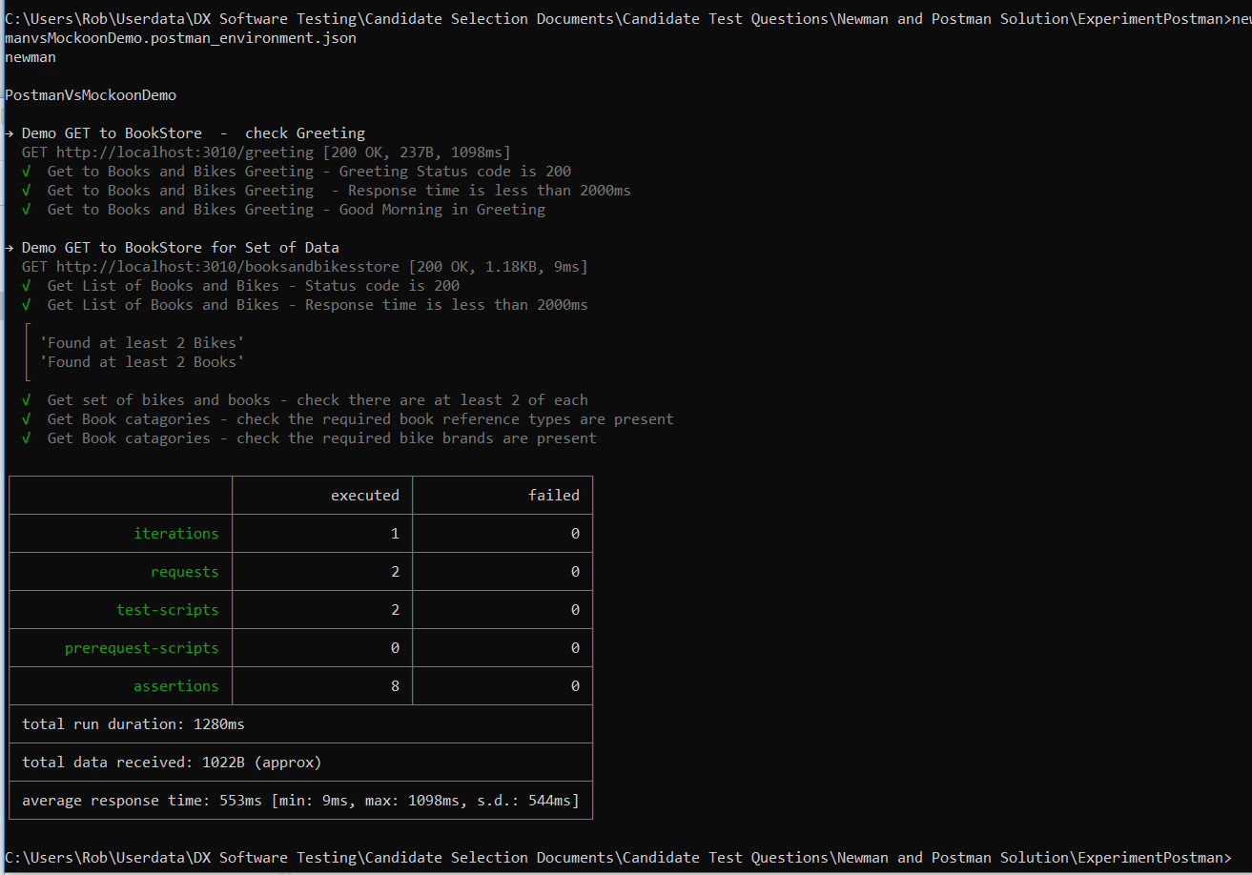
Executing tests
newman run PostmanVsMockoonDemo.postman_collection.json -e PostmanvsMockoonDemo.postman_environment.json
Expected Results
The results will then have a format as below, as well as showing detailed console logs
Strictly confidential

Slide 7
Mockoon
The Mockoon tool is very easy to use. It is downloaded as an exe, and then can be run locally - and supports a variety of OSes.
The user creates sample interfaces, defining
Whether the application works on HTTP or optionally HTTPs
Environments – organizing into environments and choosing the port where the application will listen
routes – i.e. the resources that is being called and the HTTP method (GET / POST / PATCH)
The user can define appropriate messages responses such as
HTTP status code
Message body - such as application/json or application/xml
Return delay timers
The user can then look at the submitted messages and the responses within the logs option
.
Strictly confidential
The user may need to insert message bodies, using an appropriate encoding, such as YAML, xml or json. The following shows how to typically set the content type and some validation tools for those message types (check the document syntax is correct).

Slide 8
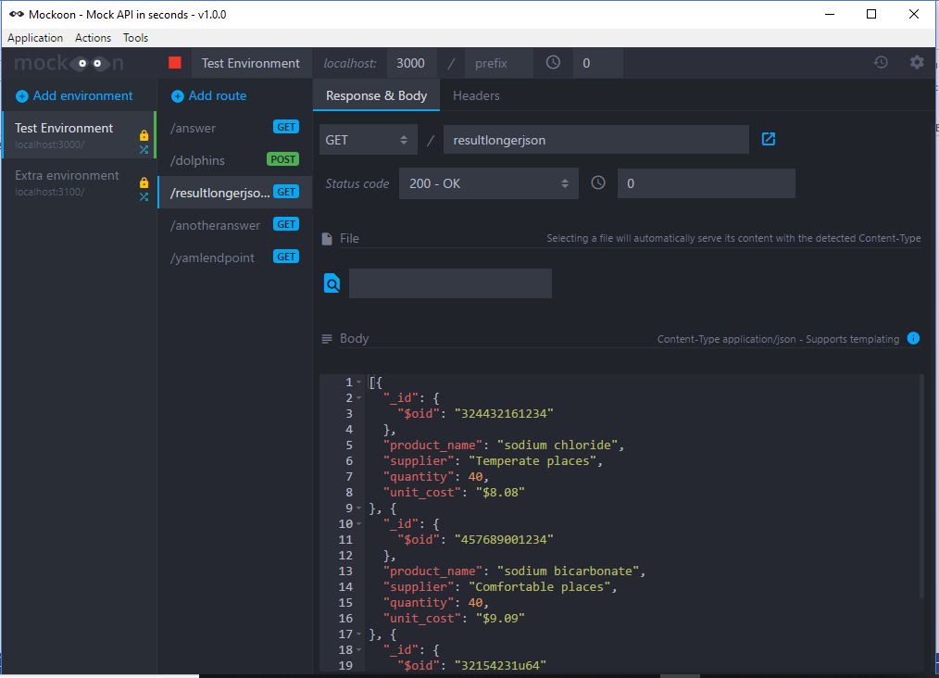
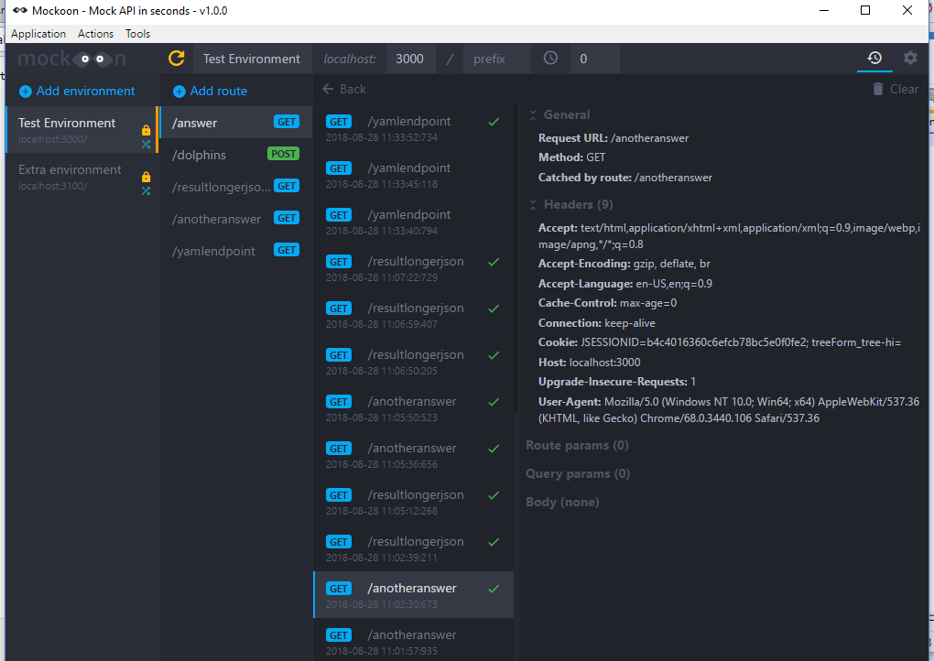
Mockoon - Screen shot
Strictly confidential
The user may need to insert message bodies, using an appropriate encoding, such as YAML, xml or json. The following shows how to typically set the content type and some validation tools for those message types (check the document syntax is correct).

Slide 9
Sample Projects
Three Sample Projects
REST to Mockoon
REST to Dummy API
GraphQL – as well as a quick overview of GraphQL
Strictly confidential

Slide 10
Sample Projects 1 – REST to Mockoon
Use the environment bikes and bookstore - please check that the environment is running
APIs to
Simple Greeting
An entity called ‘booksandbikesstore’ - Verify the response code, response time, body part sizes and use of intersection methods to check enough elements returned
Strictly confidential

Slide 11
Sample Projects 2 – REST to Dummy API
DummyAPI is an online resource that allows the tester to call a set of on line APIs can then test responses. It is available at
Here are some of this API (as of 11/04/2020)
# | Route | Method | Type | Full route | Description
1 | /employee | GET | JSON | http://dummy.restapiexample.com/api/v1/employees | Get all employee data
2 | /employee/{id} | GET | JSON | http://dummy.restapiexample.com/api/v1/employee/1 | Get a single employee data
3 | /create | POST | JSON | http://dummy.restapiexample.com/api/v1/create | Create new record in database
4 | /update/{id} | PUT | JSON | http://dummy.restapiexample.com/api/v1/update/21 | Update an employee record
5 | /delete/{id} | DELETE | JSON | http://dummy.restapiexample.com/api/v1/delete/2 | Delete an employee record
Strictly confidential

Slide 12
Sample Projects 2 – REST to Dummy API
Calls to
Create
Get
Update
Delete
Verify that Response codes
Response times
JSON body is present
Response contents - using JSON
Headers are present
Passed in value is respected
NB in some cases the dummy API service has been found to not respond - working at time of writing
Strictly confidential

Slide 13
Sample Projects 3 – GraphQL to StarWars
GraphQL allows use to run a query over an Interface and t get a response back - specifically to get back the data that you want. For example check a reservation on a date, for conference room, at a hotel. Don’t query for the hotel and the conference room and the reservation, but get all the details in one go.
Further one can use for mutations and get multiple values back.
Use the SWAPI - Star Wars API. Test vehicles starships, planets, files, species. Use a either JSON representation of GraphQL or alternatively native GraphQL
Further work in future to join elements
Strictly confidential

Slide 14
Sample Projects 3 – GraphQL to StarWars
Test verify
Status code
Response time
Existence of at least 1 JSON body
Check there are at least n entities
Check values are of the right type
Check that the full set of values is returned
Strictly confidential

Slide 15
Code location and GitHub
Code and this presentation has ben uploaded to.
To execute
REST to Mockoon
newman run PostmanVsMockoonDemo.postman_collection.json -e PostmanvsMockoonDemo.postman_environment.json
REST to dummyAPI
dummyAPI.postman_environment.json
newman run DummyAPICollection.postman_collection.json -e dummyAPI.postman_environment.json
GraphQL – as well as a quick overview
newman run GraphQLBasicCases.postman_collection.json -e swapi_environment.postman_environment.json
Strictly confidential

